Slide 1
WEEK 03 | Endpoint & Network Detection
Sysmon • Linux auditd • Snort IDS • MITRE ATT&CK T1046
DG Interns Hub / Cyber Security Internship
Evidence-first technical review
Windows 11 + Ubuntu + Kali on VirtualBox host-only lab
Prepared by Kesheth Swarnachandran • November 2026
DG INTERNS HUB • WEEK 03 | CYBER SECURITY KESHETH SWARNACHANDRAN

Slide 2
Week 3 requirements and results
Theory
10 separate question-and-answer documents
Training
4 TryHackMe rooms; 5 LetsDefend reported completed, 1 partial
Endpoint telemetry
Sysmon IDs 1, 3, 11 and auditd EXECVE
Network detection
4 custom Snort rules including SID 1000004 / T1046
Evidence quality
33 original screenshots, exact rules, documented access issue
DG INTERNS HUB • WEEK 03 | CYBER SECURITY

Slide 3
Lab topology and monitoring coverage
Test traffic was generated only within the authorized VM lab.
Ubuntu target
192.168.56.101 • Snort 2.9.20 • enp0s8 • auditd
Kali tester
192.168.56.102 • controlled ping/curl/nc/Nmap
Windows 11
192.168.56.104 • Sysmon process, network and file events
Network
192.168.56.0/24 • VirtualBox host-only subnet
DG INTERNS HUB • WEEK 03 | CYBER SECURITY

Slide 4
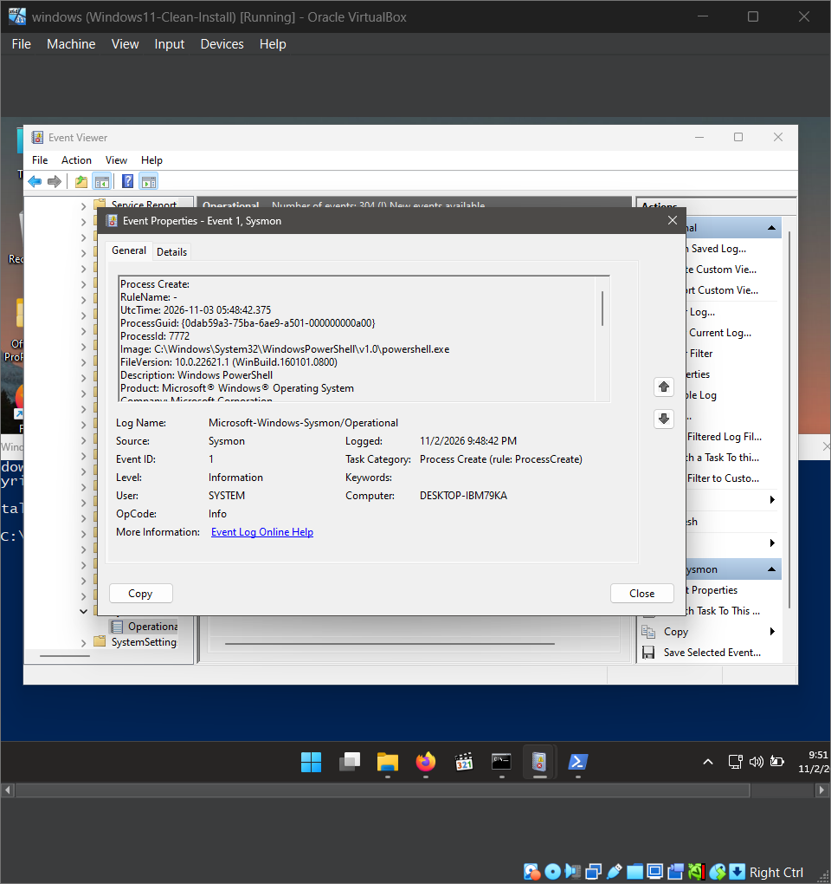
Sysmon Event ID 1 — Process Create
Evidence
WHAT THIS PROVES
Image field shows powershell.exe; process context helps correlate execution and later events.
DG INTERNS HUB • WEEK 03 | CYBER SECURITY

Slide 5
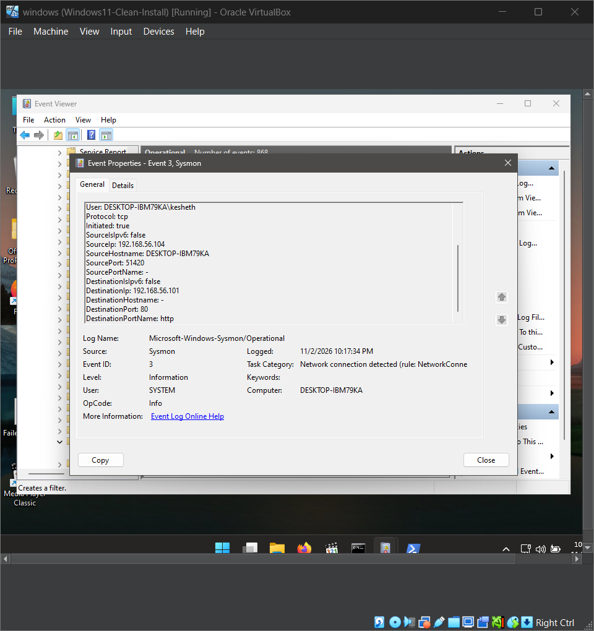
Sysmon Event ID 3 — Network Connection
Evidence
WHAT THIS PROVES
TCP 192.168.56.104:51420 → 192.168.56.101:80. A clear host-to-service connection record.
DG INTERNS HUB • WEEK 03 | CYBER SECURITY

Slide 6
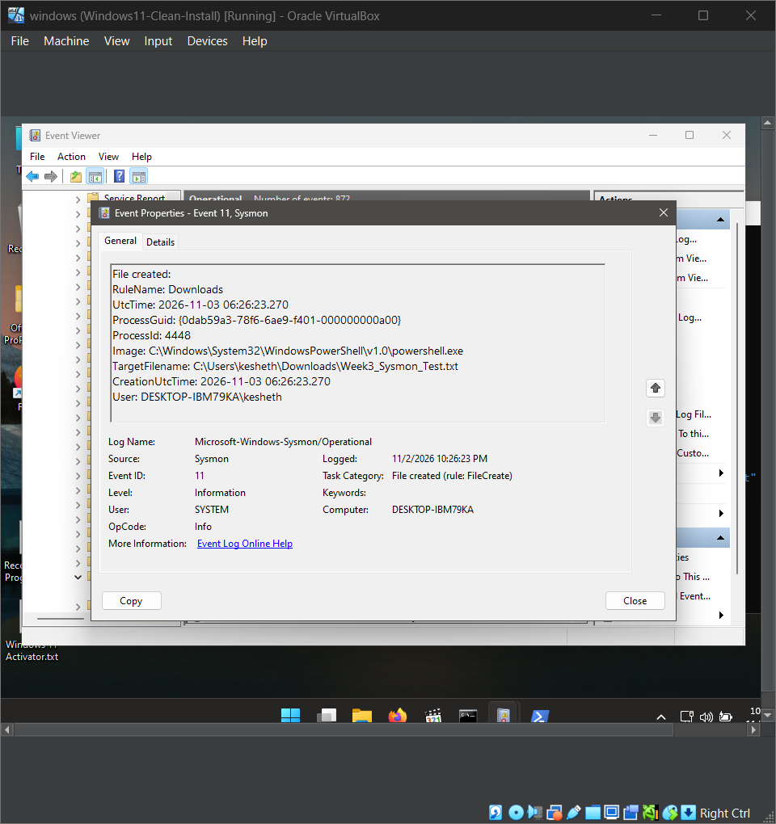
Sysmon Event ID 11 — File Create
Evidence
WHAT THIS PROVES
File: Downloads/Week3_Sysmon_Test.txt. Shows PowerShell attribution and UTC timestamp.
DG INTERNS HUB • WEEK 03 | CYBER SECURITY

Slide 7
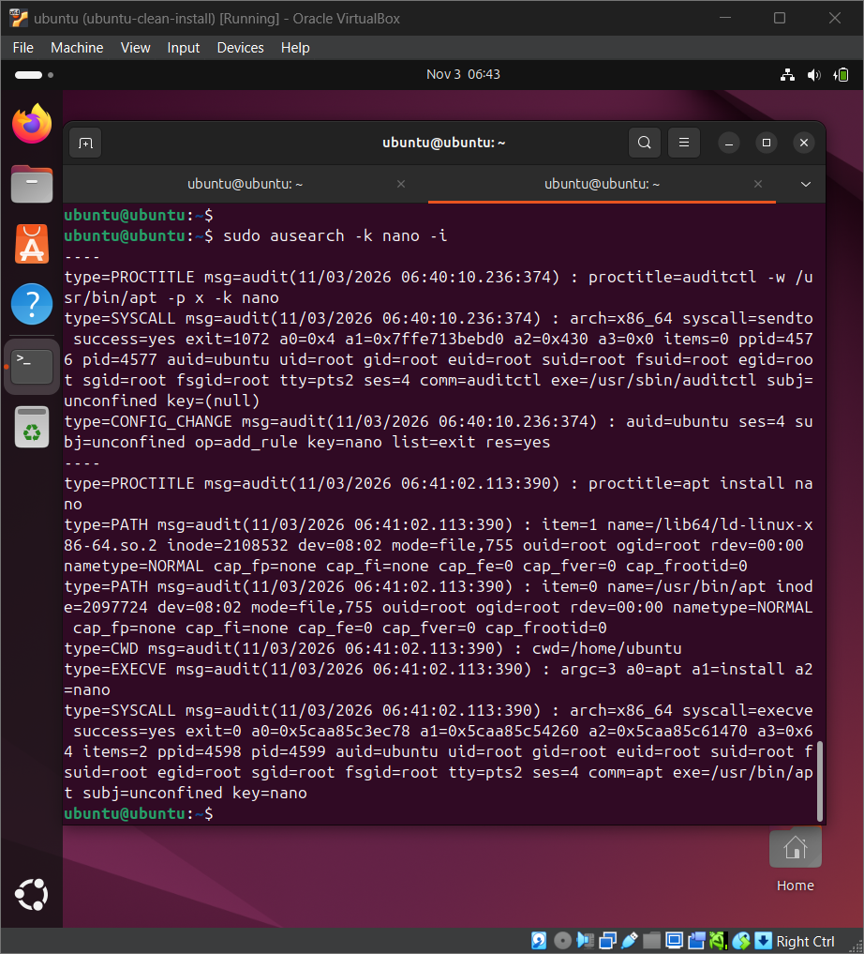
Linux auditd — Command Evidence
Evidence
WHAT THIS PROVES
ausearch -k nano -i returns EXECVE arguments apt install nano, plus PID/UID and SYSCALL records.
DG INTERNS HUB • WEEK 03 | CYBER SECURITY

Slide 8
Snort detection rule set
All four rules originated from the uploaded local.rules file.
SID 1000001
ICMP Ping Detected
SID 1000002
SSH Connection Attempt on TCP/22
SID 1000003
HTTP Traffic on TCP/80
SID 1000004
Thresholded SYN burst, tagged ATT&CK T1046
DG INTERNS HUB • WEEK 03 | CYBER SECURITY

Slide 9
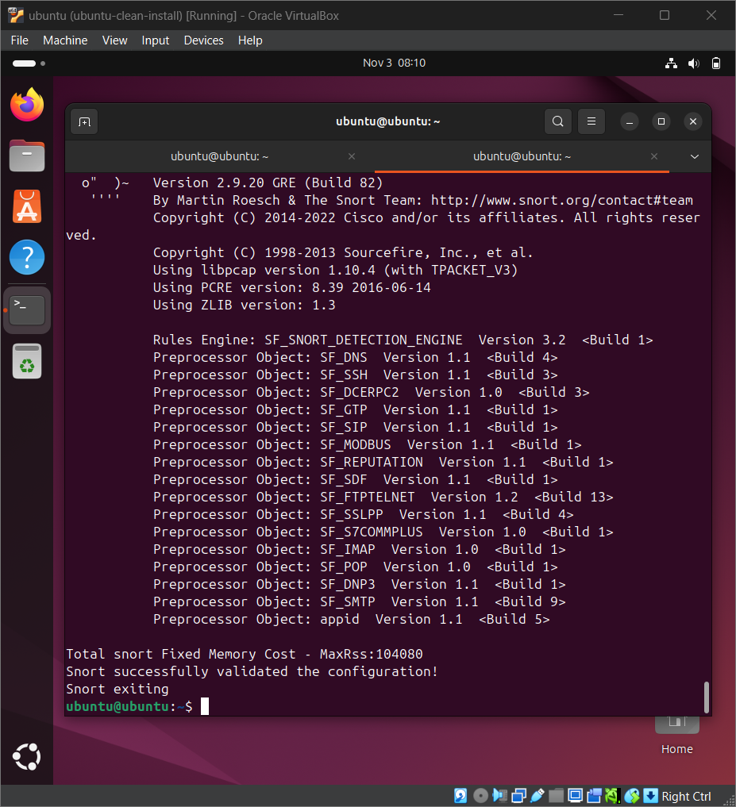
Snort — Rules Validation
Evidence
WHAT THIS PROVES
Snort test mode parsed the configured rule set; evidence captured in the Ubuntu VM.
DG INTERNS HUB • WEEK 03 | CYBER SECURITY

Slide 10
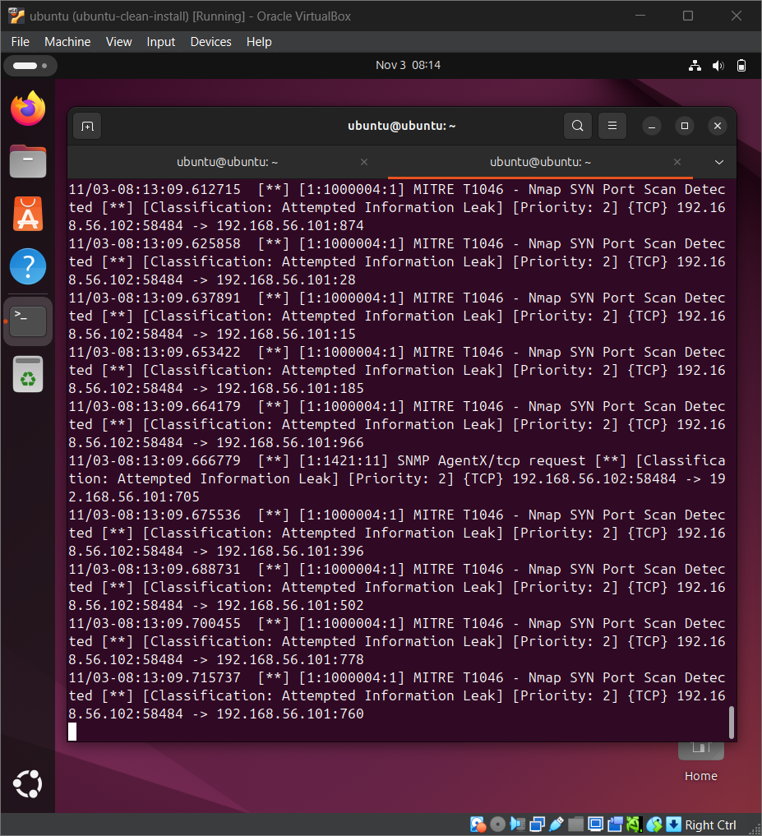
Snort — T1046 SYN Alert
Evidence
WHAT THIS PROVES
Kali nmap -sS generated a thresholded SYN detection in Snort; MITRE mapping is contextual.
DG INTERNS HUB • WEEK 03 | CYBER SECURITY

Slide 11
Debugging and lessons learned
Admin rights
Windows user creation error 5 → elevated PowerShell
Linux integration
Guest Additions issues → correct guest package + shared folder
Snort interface
Verified host-only NIC enp0s8 instead of assuming eth0
Source network
EXTERNAL_NET any for same-subnet Kali test; not a production default
Detection quality
Event ≠ attack; validate baseline, process and destination
DG INTERNS HUB • WEEK 03 | CYBER SECURITY

Slide 12
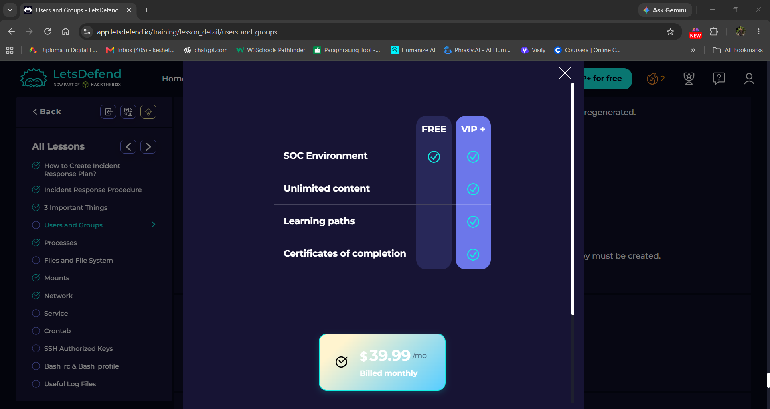
LetsDefend VIP+ — Access Limitation
Transparent documentation
WHAT THIS PROVES
The training content was readable; connecting to interactive lab opened VIP+ price screen. Lab questions remain unverified.
DG INTERNS HUB • WEEK 03 | CYBER SECURITY

Slide 13
Submission contents and next actions
Week 3 package is organized; publishing and sharing require user actions.
Notes
10 question documents and 16-entry cheat sheet
Writeups
4 TryHackMe + 6 LetsDefend + 4 practical
Reports
Weekly DOCX report and PDF with evidence figures
Evidence
Original PNG evidence organized by source
To finish externally
Publish two LinkedIn posts, upload Drive folder, submit link
DG INTERNS HUB • WEEK 03 | CYBER SECURITY

